Slide 1
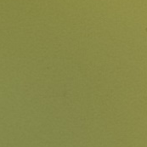
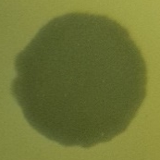


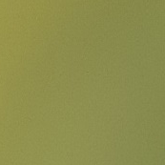



Figure S4
P22
+
+
Mitomycin C
–
+
BIST^{WT}
BIST^{CIP}
BIST^{LAB}
BIST^{MDR}

